Slide 1

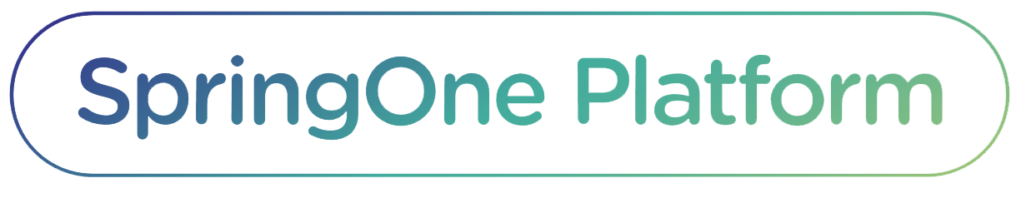
SEPT 24 - 27 2018, WASHINGTON, D.C.
.NET Smart Bulb Microservices
Tim Hess, Sr. Software Engineer
Jenny McLaughlin, Sr. Platform Architect
Pivotal

Slide 2









Steeltoe
Spring Cloud
Services
Service
Registry
Config
Server
Circuit
Breaker
And more…
https://steeltoe.io

Slide 3
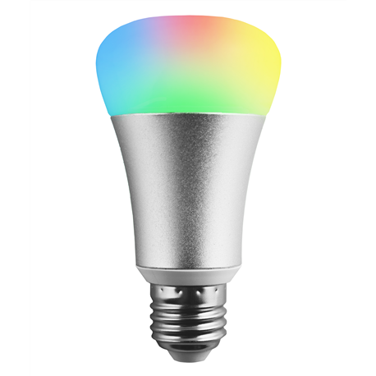
Password Strength Powered Smart Bulb
1
Smart Bulb UI
generate password
Circuit
Breaker
2
Analyze password strength and convert to RGB color code
3
send color code
Smart Bulb
Like the demo? Tweet with #cfbulbs

Slide 4
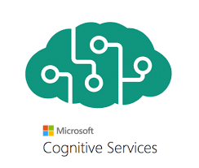
Sentiment Powered Smart Bulb
Text Input
1
2
request sentiment analysis
Smart Bulb UI
Config
Server
3
4
send color code
Convert score to RGB color code
Smart Bulb
Like the demo? Tweet with #cfbulbs

Slide 5
Like the demos?
Tweet with #cfbulbs

Slide 6

Real-time Feedback Powered Smart Bulb
latest #cfbulbs tweets
Twitter Monitor
Service
Registry
1
2
request sentiment analysis
Smart Bulb UI
Config
Server
3
4
send color code
Convert score to RGB color code
Smart Bulb
Like the demo? Tweet with #cfbulbs

Slide 7
Have Some Fun
See How Easy This Was:
https://github.com/Pivotal-Field-Engineering/smart-bulbs
Go Cloud Native with Your .NET Applications
Centralize your app configurations
Discover services intelligently
Wrap integration points with circuit breakers
Manage credentials with Credhub API
Steeltoe Documentation:
https://steeltoe.io

